Slide 1
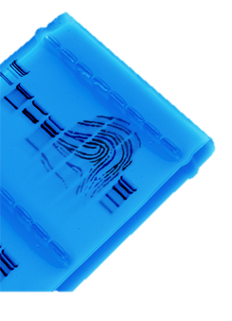
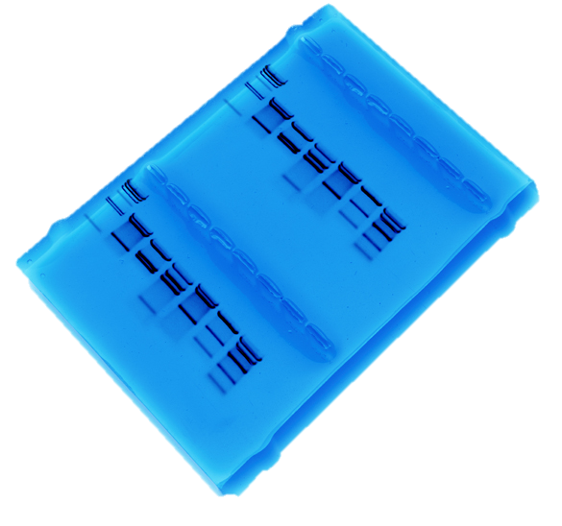
Use Pop-Culture in Your Classroom
Bio-Rad Biotechnology Explorer DNA Fingerprinting Kit

Slide 2
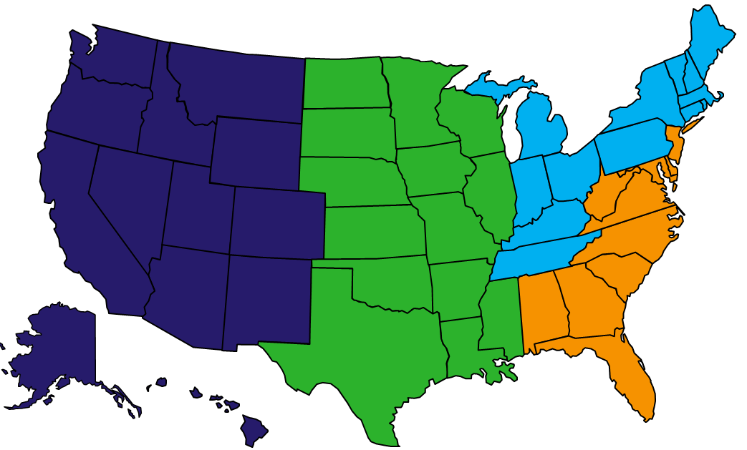
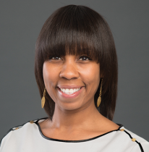

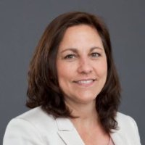
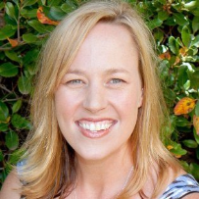
Curriculum and Training Specialists
Damon Tighe
damon_tighe@bio-rad.com
Tamica Stubbs
tamica_stubbs@bio-rad.com
Sherri Andrews, Ph.D.
sherri_andrews@bio-rad.com
Leigh Brown
leigh_brown@bio-rad.com

Slide 3
Bio-Rad Resources
@BioRadEducation
Biotechnology: A Lab Skills Course
Pinterest.com/teachbiology
bit.ly/b-rdropbox

Slide 4





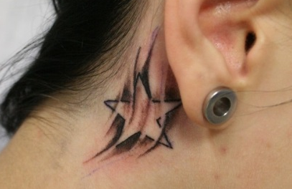

What is Pop Culture?
Pop Culture is the entirety of ideas, perspectives, attitudes, images, and other phenomena that are within the mainstream of a given culture.

Slide 5
Why use pop culture in the classroom?
“Screen-time” stats (TV or computer screens)
  60% teens – 20 hr/wk
  33% teens – 40 hr/wk
  7% teens – 50+ hr/wk
Increase student interest and engagement
Conduit for connecting student knowledge & interests to classroom content
Opportunity to address scientific misconceptions that result from pop culture references (eg. TV shows & movies)
Notes:
http://www.sciencedaily.com/releases/2008/03/080312172614.htm

Slide 6
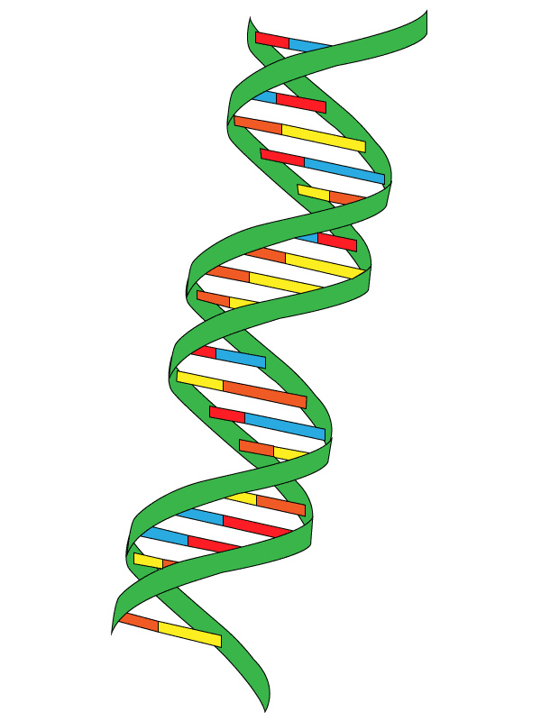
Learning objectives of this workshop
How do you use a DNA Fingerprinting Lab in the context of a pop culture story in your classroom?
What are some misconceptions about DNA perpetuated through Forensic Science Popularity & how can you use class time to address them?
How do you choose a pop culture reference to use in a class lab?
How do you adapt a pop culture reference for lab data analysis to create a premise or story?
How do you meet standards by integrating a pop culture reference?

Slide 7

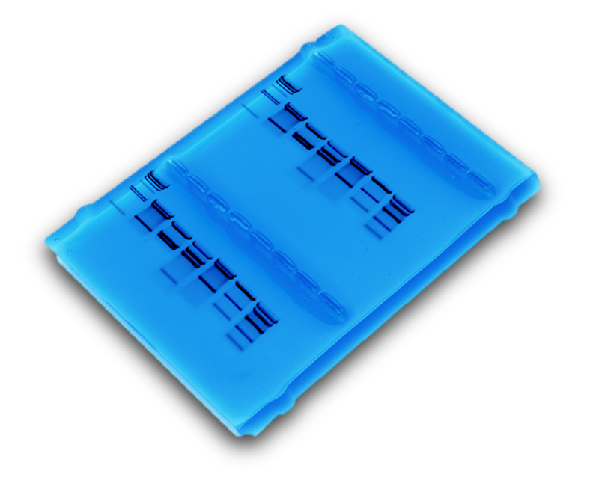
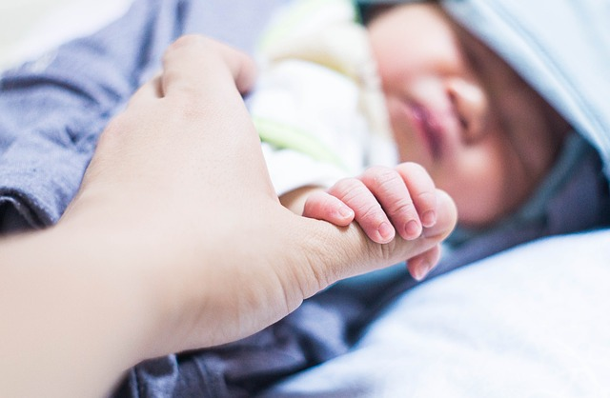
What is DNA Fingerprinting?
Common DNA Pop Culture References?
Solving Crimes
Establishing Paternity
Notes:
First thing that comes to mind: DNA. It is revered and is iconic in today’s culture. Is it all about crime? Paternity? Can we use this credible process to derail some current misconceptions that students may have and develop student creativity in the process?

Slide 8
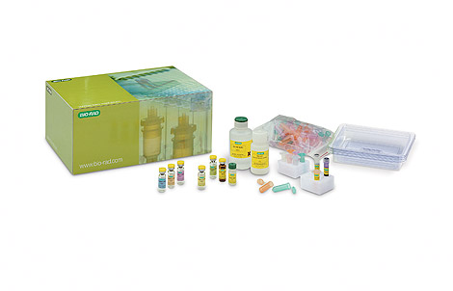
Misconceptions of DNA via Forensics & Pop Culture!
Crime Scene Investigations
Forensic scientists only work on murders
They’re raking in the cash
They interrogate suspects and make arrests
DNA evidence wraps up every case
Tests are done in a matter of hours
Forensic analysts never make mistakes
Criminals always make mistakes
Forensics labs are high-tech and stocked with all necessary equipment,
Crimes are solved quickly
You have to have a catchy one-liner about every death
Notes:
So frequently used, often dilutes reality of its potency and/or capacity. To correct, we must first address/acknowledge! Ask

Slide 9

Shifting Student Perceptions: DNA Fingerprinting- Creating Pop Culture Cliques & Lab Teams!
Generate list of student favorite shows
&/or movies!
Narrow pop culture picks to
8 options!
Group students according to interests!
PCC groups run DNA FP lab & build story as a unit!
Notes:
To create a shift, you must meet students where they are. Capitalize on the power of pop culture and student interests to focus their attention on content, to grow their knowledge bases and encourage collaborative efforts.

Slide 10
Considerations when narrowing student group pop culture references.
Is it age appropriate and relevant?
Is it overly fantastical?
  Overly fantastical references can interfere with learning and exacerbate misconceptions
Can students build a story to fit the DNA Fingerprinting lab? If it isn’t perfect, can you use it for discussion?
Other considerations?

Slide 11
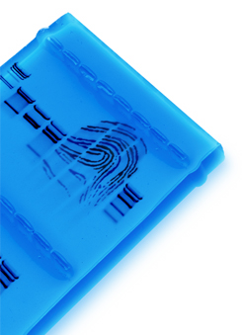
Shifting Student Perceptions: DNA Fingerprinting – Additional Applications
Crime scene
Human relatedness
Paternity
Animal relatedness
Anthropology studies
Disease-causing organisms
Food identification
Human remains
Monitoring transplants
Notes:
DNA analysis transcends a multitude of topics. These variations help to build diverse contexts in the classroom, and can enhance student creative explorations.

Slide 12
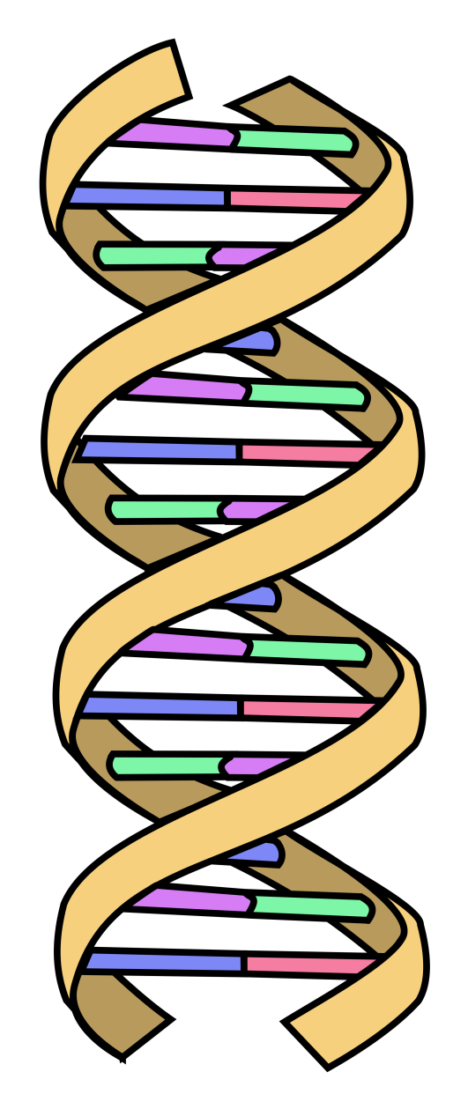
Priming students for Activity Success: Reviewing DNA Structure and Function
Gene
Protein
Trait
Notes:
DNA is universal to all life. Codes for protein-trait-phenotype and can be visualized/read using electrophoresis.

Slide 13
Priming students for Activity Success: Reviewing DNA Analysis Procedures.
Screening Source & DNA Extraction!
Analyze, Interpret & Report!
Clean & Quantify!
Amplify
&
Detect!
Notes:
If this graphic represented a 15 hour cycle, the progression of processes required to analyze DNA thoroughly would be reflected as seen here. Note: Batch processing is considered here.
Process: Serology/Screening - varies, Extraction 5min-2hours, Cleaning up and Quantifying up to 3 hours, Amplifying and Detection up 6 hours, Analyze, Interpret & Report up 4 hours

Slide 14
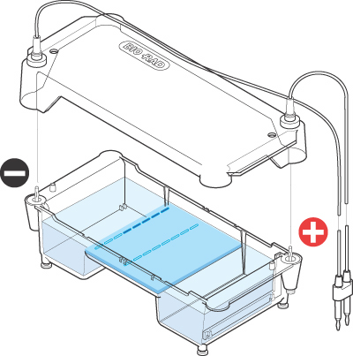
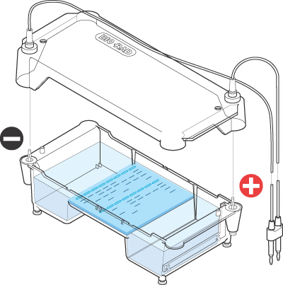

Overview of DNA Detection: Agarose Electrophoresis
Agarose gel separates DNA fragments according to size
Electrical current carries (-) charged DNA through gel to (+) electrode.
Small fragments move faster than large fragments
Buffer
DNA &
Loading Dye
Agarose
gel
Power Supply

Slide 15
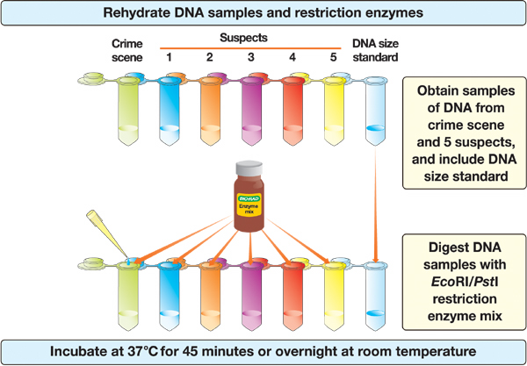
DNA Fingerprinting Kit Overview

Slide 16
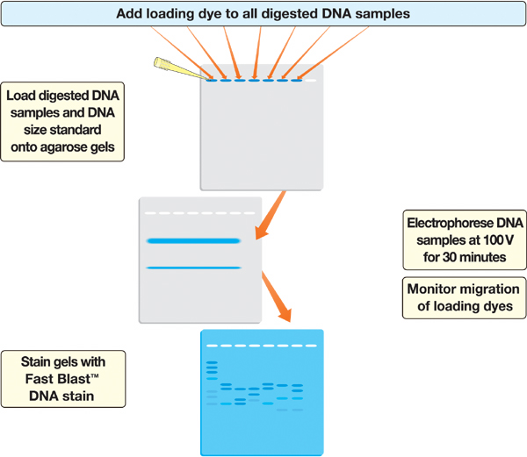
DNA Fingerprinting Kit Overview (cont.)

Slide 17
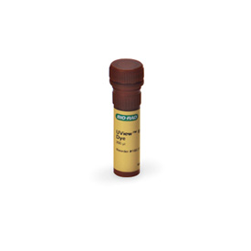
DNA Fingerprinting Kit Overview: Time Saving Adjustment- Using UView!
Electrophorese DNA samples at 200V for 20 minutes.

Slide 18
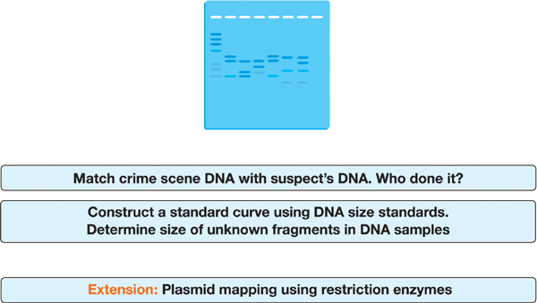
DNA Fingerprinting Kit Overview (cont.)
STOP

Slide 19
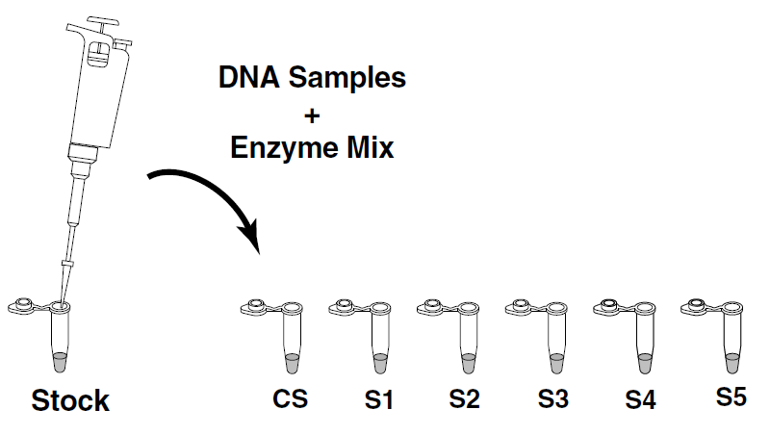
Let’s Get Started: Preparing DNA Samples!
Organize into 8 groups (pop culture cliques)!
2. Choose a member of your group to pick up five 3 x 5, colored index cards at the gel stations!
C1
C2
C3
C4
C5
3. Label DNA (20µl) samples/tubes with their corresponding character names & additional tube (green) with CS or ? !
Note that the additional DNA sample in question will implicate one of the characters but doesn’t have to imply a severe crime. Students will design their stories in the end.

Slide 20
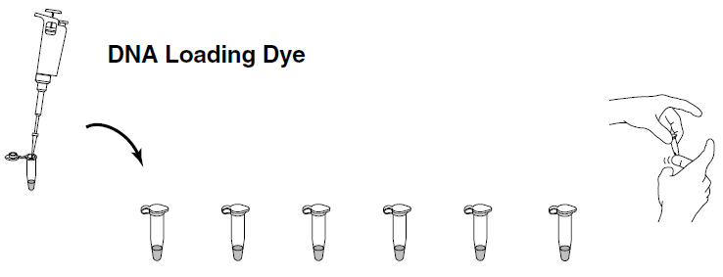
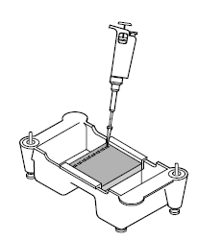
Detecting Processed DNA Samples:
Gel Electrophoresis
Add 4 µl of UView loading dye (ULD) into each of your samples. Use a separate tip for each sample! Cap the tubes and mix by flicking with your finger.
UView
2. Place an agarose gel in the gel box. Make sure the wells are near the black (-) electrode.

Slide 21
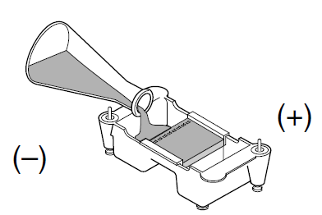
Detecting Processed DNA Samples:
Gel Electrophoresis (cont.)
3. Fill the electrophoresis chamber with 1x TAE buffer to cover the gel,.
4. Using a separate tip for each sample, load your gel:
  Lane 1: M, DNA size marker, 10 μl
  Lane 2: CS, green, 20 μl
  Lane 3: S1, blue, 20 μl
  Lane 4: S2, orange, 20 μl
  Lane 5: S3, violet, 20 μl
  Lane 6: S4, red, 20 μl
  Lane 7: S5, yellow, 20 μl
Notes:
The Bio-Rad demo video is hyperlinked to the words “load your gel”.

Slide 22
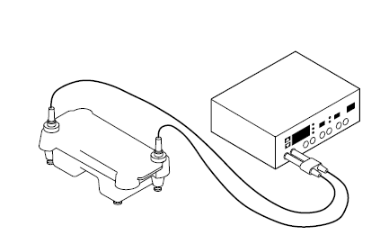
Detecting Processed DNA Samples:
Gel Electrophoresis
5. Place the lid on the gel box, and plug the electrodes into the power supply. Electrophoresis at 200V for 20 minutes.
6. Put your group’s Pop Culture reference, 5 suspects and a 2 sentence Crime Scenario or Paternity plot on your cards.

Slide 23
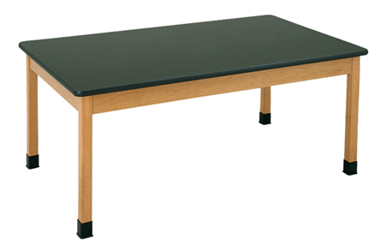
Kinesthetic Learning: Classroom Obstacle Course

Slide 24
While we wait……discussion points for the DNA Fingerprinting Lab in class!
Lab Processes:
Stain & Analyze Gels
Load & Run Gels
DNA Digest
Staining
DNA S&F
DNA’s Power
Skipped Steps
R. Enzymes
Misconceptions
Addressed!
Skipped Steps
Electrophoresis
Data Collection
Class Discussion:
Notes:
Claim Evidence Reason Worksheet would be great when examining misconceptions and using the lab to correct these

Slide 25

Analysis of Stained Gel
• Create standard curve using DNA marker
• Measure distance traveled by restriction fragments
• Determine size of DNA fragments
• Determine which suspects can be excluded

Slide 26
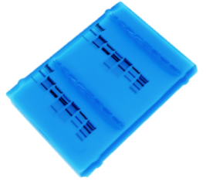
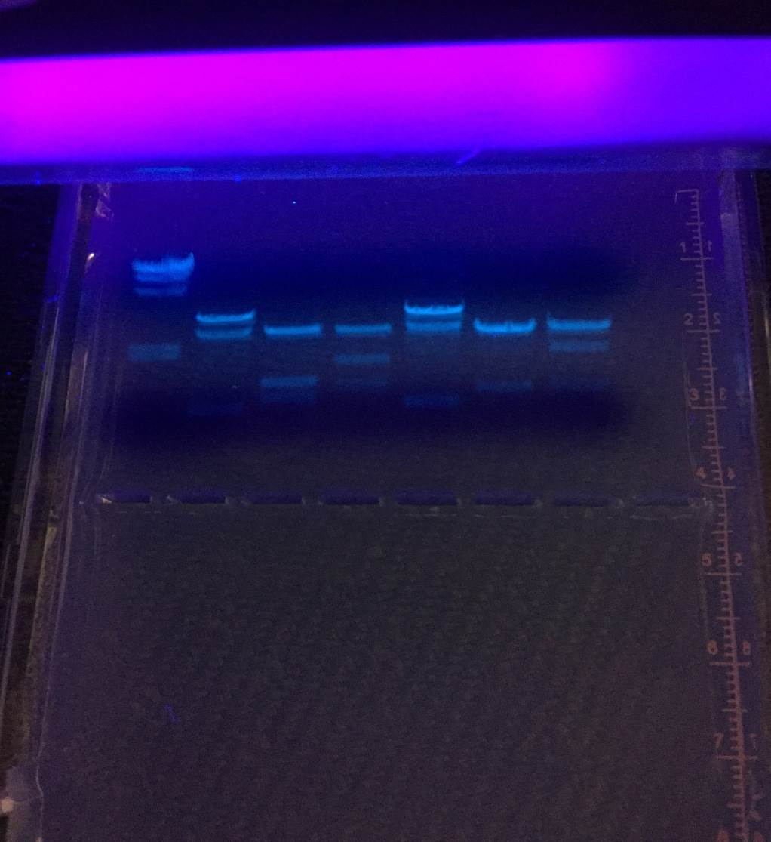
Use data from gels to apply to your selected pop culture reference.
Get students to write creatively:
Who is suspect #3?
What role do they have in the show or movie?
How can the data be used to create a scenario/ screen play proposal for these characters while remaining true to the story line and the actual science.
Exchange cards with another group and construct the story based upon the gel results they have.

Slide 27
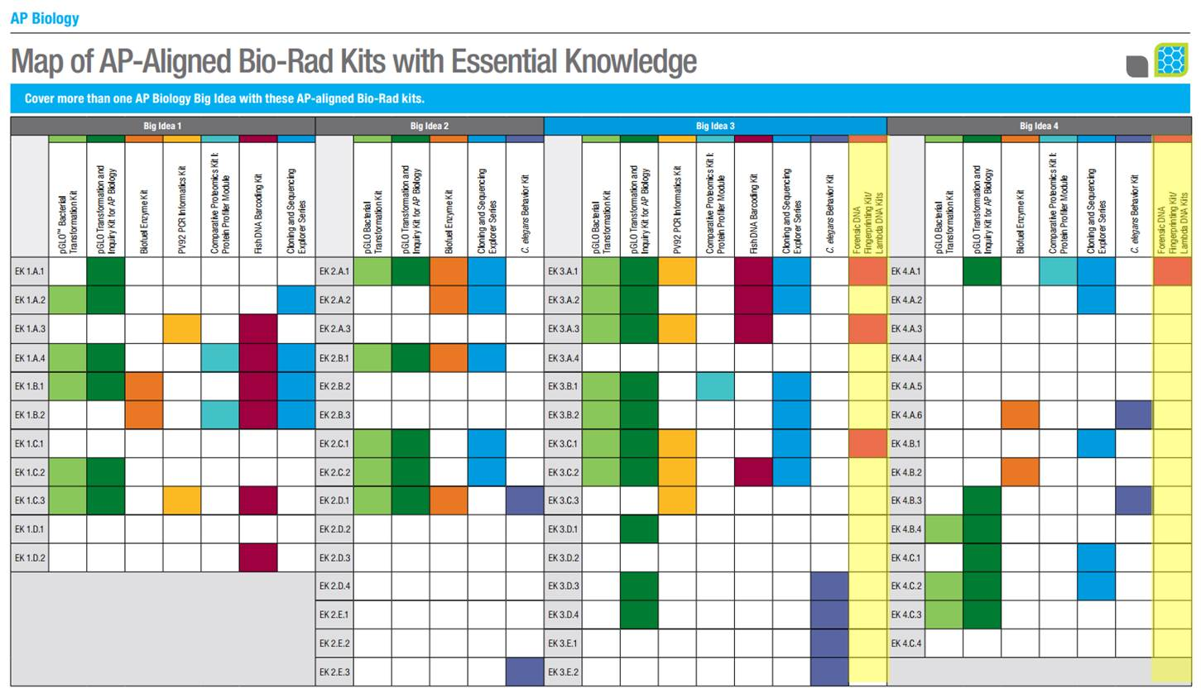
AP Alignment

Slide 28
NGSS Alignment

Slide 29
Wrapping Things Up
Thank you for attending. Please fill out the workshop survey!
Question!
Question!

Slide 30
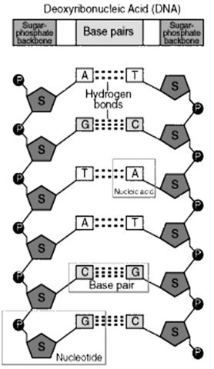
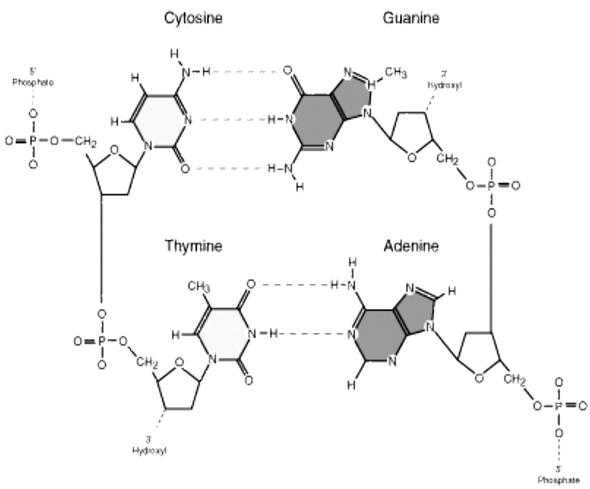
DNA Structure

Slide 31
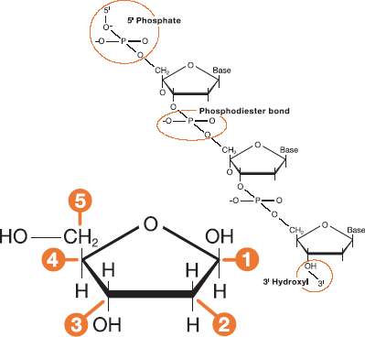
DNA Schematic

Slide 32
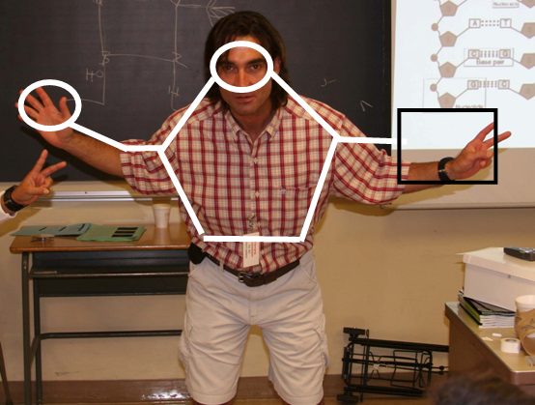
Student DNA Model

Slide 33
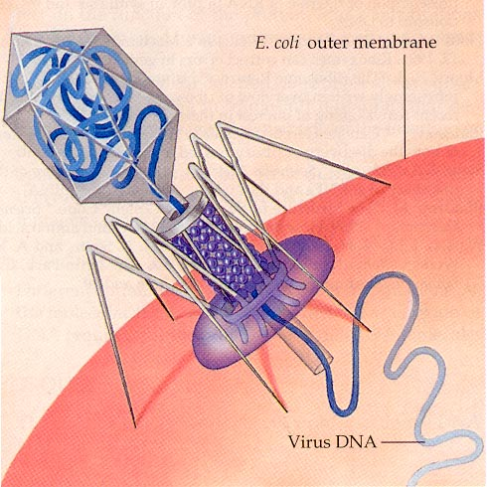
Restriction Enzymes
• Evolved by bacteria to protect against viral DNA infection
• Endonucleases = cleave within DNA strands
• Over 3,000 known enzymes

Slide 34
DNA Digestion Reaction
Restriction Buffer provides optimal conditions
NaCI provides the correct ionic strength
Tris-HCI provides the proper pH
Mg²⁺ is an enzyme co-factor

Slide 35


Enzyme Site Recognition
Restriction site
• Each enzyme digests (cuts) DNA at a specific sequence = restriction site
• Enzymes recognize 4- or 6- base pair, palindromic sequences
(eg GAATTC)
Palindrome
Fragment 1
Fragment 2

Slide 36
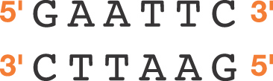

5 Prime Overhang
Enzyme cuts

Slide 37
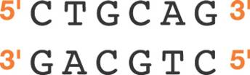
Common Restriction Enzymes
EcoRI
– Eschericha coli
– 5 prime overhang
Pstl
– Providencia stuartii
– 3 prime overhang

Slide 38
Restriction Fragment Length Polymorphism
RFLP
PstI
EcoRI
CTGCAG
GAGCTC
GAATTC
GTTAAC
Allele 1
1
2
3
CGGCAG
GCGCTC
GAATTC
GTTAAC
Allele 2
Fragment 1+2
3
Different
Base Pairs
No restriction site
M
A-1
A-2
Electrophoresis of restriction fragments
M: Marker
A-1: Allele 1 Fragments
A-2: Allele 2 Fragments
+

Slide 39
DNA Digestion Temperature
Why incubate at 37°C?
  Body temperature is optimal for these and most other enzymes
What happens if the temperature is too hot or cool?
  Too hot = enzyme may be denatured (killed)
  Too cool = enzyme activity lowered, requiring longer digestion time

Slide 40

How to load an agarose gel

Slide 41
Gel Electrophoresis
Collect your DNA samples from the water bath.
Add 5 ul of loading dye (LD) into each of your tubes. Use a separate tip for each sample! Cap the tubes and mix by flicking with your finger.

Slide 42
Gel Electrophoresis
Place an agarose gel in the gel box. Make sure the wells are near the black (-) electrode.
Using a separate tip for each sample, load your gel:
  Lane 1: M, DNA size marker, 10 μl
  Lane 2: CS, green, 20 μl
  Lane 3: S1, blue, 20 μl
  Lane 4: S2, orange, 20 μl
  Lane 5: S3, violet, 20 μl
  Lane 6: S4, red, 20 μl
  Lane 7: S5, yellow, 20 μl

Slide 43
Gel Electrophoresis
Place the lid on the gel box, and plug the electrodes into the power supply. Electrophoresis at 200V for 20 minutes.

Slide 44
Agarose Electrophoresis
Agarose gel separates DNA fragments according to size
Electrical current carries (-) charged DNA through gel to (+) electrode.
Small fragments move faster than large fragments
Buffer
DNA &
Loading Dye
Agarose
gel
Power Supply

Slide 45
Analysis of Stained Gel
• Create standard curve using DNA marker
• Measure distance traveled by restriction fragments
• Determine size of DNA fragments
• Determine which suspects can be excluded

Slide 46
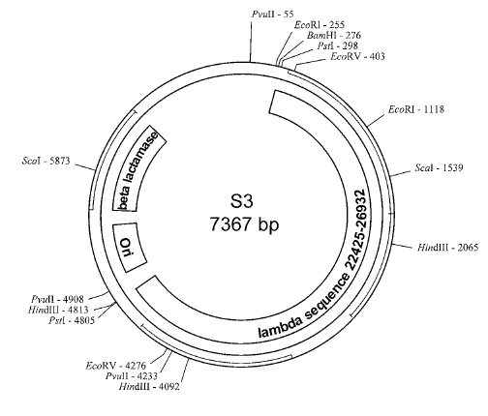
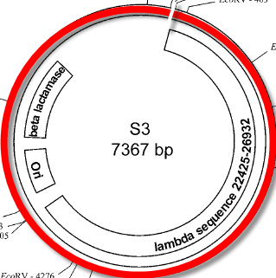
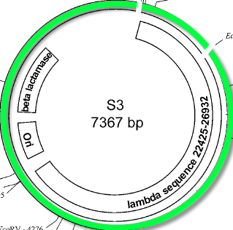
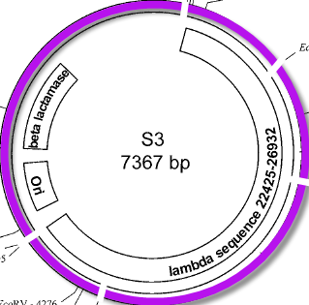
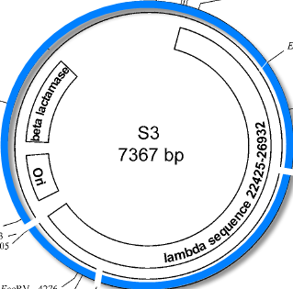
Plasmid Map and Restriction Sites
863bp
3469bp
863bp
2027bp
BamHI
Hind III
EcoRI
EcoRI+ HindIII
947bp
721bp
7367bp
721bp
1659bp
2027bp
6504bp
BamHI:
EcoRI:
HindIII:
EcoRI+Hind III:
1 linear fragment; 7367bp
2 fragments; 863bp / 6504bp
3 fragments; 721bp/2027bp/3469bp
5 fragments; 721bp/863bp/947bp/1659bp/2027bp

Slide 47
Agarose Electrophoresis
• Electrical current carries negatively-charged DNA through gel towards positive (red) electrode
Buffer
Dyes
Agarose gel
Power Supply

Slide 48
Agarose Electrophoresis
Agarose gel separates DNA fragments according to size
Electrical current carries (-) charged DNA through gel to (+) electrode.
Small fragments move faster than large fragments
Buffer
DNA &
Loading Dye
Agarose
gel
Power Supply

Slide 49
Analysis of Stained Gel
• Create standard curve using DNA marker
• Measure distance traveled by restriction fragments
• Determine size of DNA fragments
• Determine which suspects can be excluded

Slide 50
Molecular Weight Determination
Fingerprinting Standard Curve: Semi-log
Size (bp) Distance (mm)
23,000 11.0
9,400 13.0
6,500 15.0
4,400 18.0
2,300 23.0
2,000 24.0

Slide 51
“Statistically, how many people in a population have the same pattern as that taken from a crime scene: 1 in 1,000,000? 1 in 10,000? Or, 1 in 10?”

Slide 52
GATTACA and DNA FP
GATTACA clip?
Introduce FP and how to frame it with the movie
  I’ve left slides from previous DNA FP ppt at the end of this ppt in case you want to reuse it
FP kit workflow
Instructions for loading gel (is this a removable module in case we only get 60 mins?)
Teachers will load gels with precut DNA with uview – damon is this true?
Add whatever slides you need here to get teachers through this

Slide 53
Data Analysis
Go through analysis of bands on gel (photo of prerun gel)
Maybe have teachers do the analysis
Data that they will analyze – does a photo already exist or does jeannie need to create it (please tell jeannie either way)

Slide 54
Create other pop culture stories for this lab and other labs
House - identify a bacteria, medical diagnostics
Bones – forensic, innocence project
Jurassic world – genetic engineering, bioethics, environmental science (balance of populations)
Others?

Slide 55
How did this align to your curriculum?
Add alignment here to AP? NGSS? TEKS?
Ask them for suggestions? Think pair share?
I don’t know if we have time for this (probably not) but it would be cool to ask teachers to align the FP DNA lab to their curriculum early in the workshop, before the pop culture framework is introduced, then ask them again here to see what additional alignments they can make. Just an idea

Slide 56
DNA FP info
Kit info where to buy
Additional equipment needed

